Slide 1


Subject: Minor Project1 Subject Code: 21E-CSR-288 Semester: Feb 2021- June 2021 Topic: Media Viewer

Slide 2
Tables of Content
Media Viewer
Need of Media Viewer
Why this Media Viewer?
Features of Media Viewer
Source code File
Output Generated
Pros and Cons of Media Viewer
References

Slide 3

Media Viewer
Everyone loves to watch movies or video clips on their laptops and computers. All you need is one video player that delivers excellent sound and picture quality. There are hundreds of video players available on the Internet, and all proclaim to be good.
Media Viewer is an alternative photo and media viewer that is capable of showing meta information associated with images. This is particularly helpful if you organize and describe your photos.

Slide 4
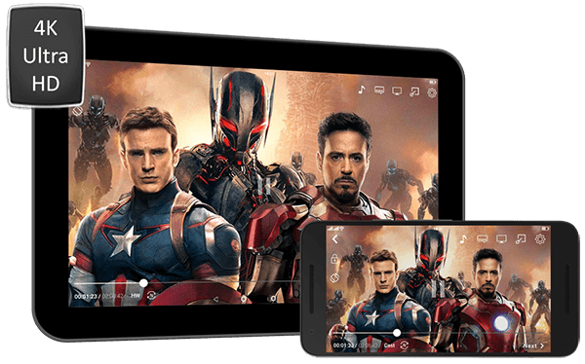
Contd.
Our goal is to improve the viewing experience for readers and easygoing editors on Wikipedia and Wikimedia locales. This new media program shows pictures in bigger size, with helpful data about their substance, creators and related metadata. Preview larger images, enlarge images, Browse related files. Offer more highlights, for example, extend, download, share and install. Primary users for Media Viewer are readers, casual editors and other users include experienced editors, contributors.

Slide 5

Need of Media Viewer
User research suggests that the current file page brings up many issues for readers like too much information, cluttered visual layout, emphasizes text over images, longer load times and nowadays, smartphones have become an essential source of entertainment, with the help of which people can entertain themselves, and along with that , they can stay connected with the world virtually.
But the main point is that there are several applications that we would have to install in our smartphones and they can get rid of our boredom along with taking help from any external application. A couple of years ago offline media, including movies and music was the only source of entertainment and in this era of OTT platforms, some people still prefer playing media on the smartphones that they have downloaded from torrent or any other platform and for this, it requires some special applications that can run all file forms.

Slide 6

Why this Media Viewer ?
This media viewer has the compatibility of playing most types of files, along with that, it supports several codecs that enhance its compatibility.
It has the support of almost every android version, which states that you would be able to play nearly every kind of media format on any android device.
It is an extremely convenient and effective media viewer that you ill ever use in your android smartphone.
Media Viewer offers a practical solution for readers, by making it easier to:
preview larger images
enlarge images
browse related files
read image captions
see a short summary

Slide 7

Features
Free and the best video player.
It is compatible with almost all the previous versions of Windows as well as the latest Windows 10.
Having a user-friendly interface and advanced functions.
It is a versatile player that can play any video quickly.
It has built-in support for all the popular media and video formats.
Loaded with tons of features, this video player is tremendously customizable.
With features like adding video effects, capturing the video and controlling the playback speed, it is taking the market of video players by storm and will be loved by millions.

Slide 8
Source Code File
Link to open the .ipynub file or .py file
https://drive.google.com/drive/folders/1dhGUq7yYk3fMaFlNJj_VC01jqKYxpfPj?usp=sharing

Slide 9

Output Generated

Slide 10
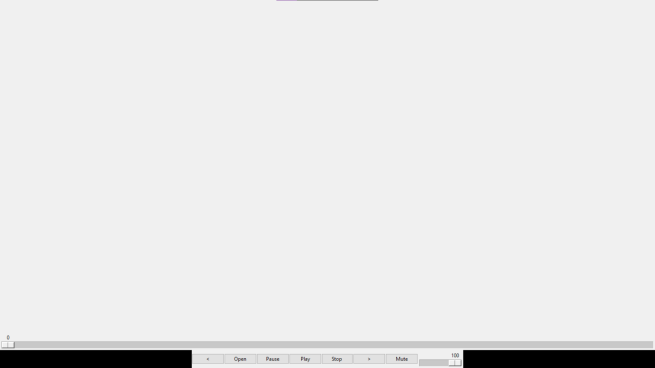
Output Generated

Slide 11
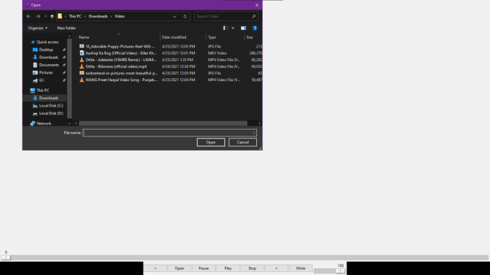
Output Generated

Slide 12
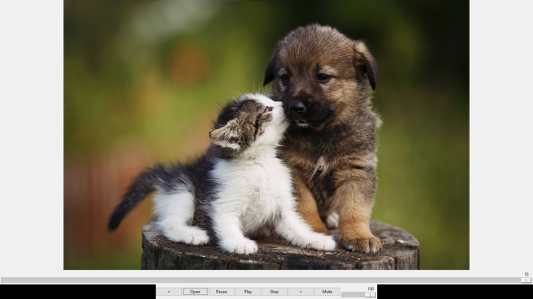
Output Generated

Slide 13
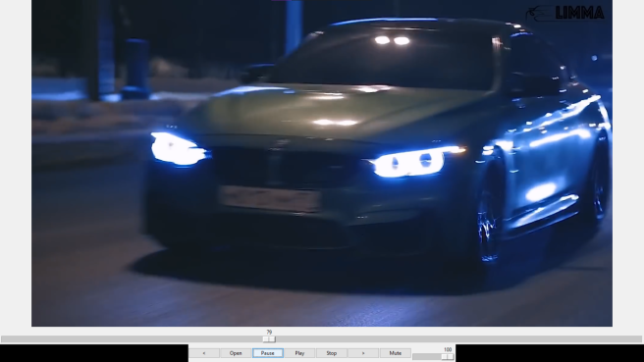
Output Generated

Slide 14
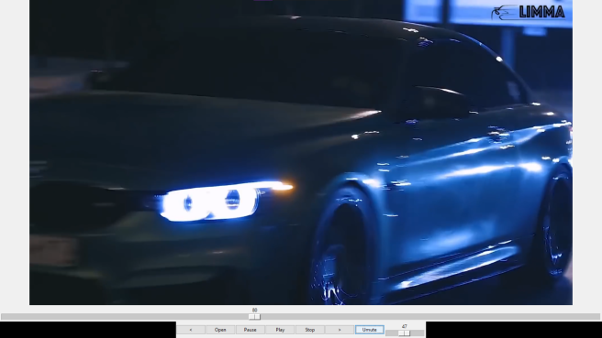
Output Generated

Slide 15
Pros and Cons
Pros of Media Viewer
Cons of Media Viewer
It can open various type of files like photos,videos,audio.
It supports various popular file formats like jpg, png and other photo formats.
It supports various popular formats of videos like mp4, mkv, avi and all other video formats supported by vlc library.
It also supports all popular audio formats like mp3, mp2, and others as well.
When we are using this software for playing media file we will not need other players i.e. separate players for photo, video and pics.
It is not as advance as other video players available in world but it does the job and we can improve it to add more features.
Currently it only works correctly on 1080p displays and also it is not scalable

Slide 16
References
https://en.wikipedia.org/wiki/Windows_Media_Player#:~:text=Windows%20Media%20Player%20%28%20WMP%29%20is%20a%20media,on%20Pocket%20PC%20and%20Windows%20Mobile%20-based%20devices.
https://www.mobipicker.com/10-best-video-players-windows-use/
https://support.microsoft.com/en-us/windows/windows-media-player-d10303a5-896c-2ce2-53d4-5bd5b9fd888b
http://vlc-media.wikidot.com/
http://www.adobe.com/products/mediaplayer/

